Slide 1
Logging in Azure

Slide 2
Why we need Logging ?
Logging is recording the state of the application and what actions are performed on it.
Can not debug in production.
Go to place to understand what is happening in our application.
Finding root causes for incidents.
Collecting audits on who is using our application and how.
Operations and Support personnel don’t have access to source code but will have access to logs which they can forward to the respective team.

Slide 3
What should we log ?
Information about start up and shutdown of the application or any lifecycle event.
Action taken by the users (Audits)
Errors and exceptions.
Checkpoints in code.

Slide 4
What shouldn’t we log ?
Personal Identifiable information (First Name, Last Name, Date of Birth, Email Id, Aadhar number, SSN, etc.)
User’s private data (Emails, Passwords, Auth tokens, financial data, etc.)
Sensitive data (Connection strings, Service passwords, Auth tokens, etc.)

Slide 5
Unstructured Logging
With unstructured logging the events in our application are expressed in plain English.
Examples include –
console.log function
printf function
Console.WriteLine
Debug.WriteLine
Trace.WriteLine
With this type of logging searching and sifting through the logs becomes extremely difficult.
Also, it poses another problem of not able to correlate the logs between HTTP requests.

Slide 6
Structured Logging
Structured logging addresses the limitation of beforementioned unstructured logging.
It gives the following benefits –
Easier searching and sifting through them
Improved readability
Standardized structure
Easier parsing
We can store structured logs in a variety of ways –
Common log format
JSON
XML

Slide 7
Log levels
We need to group logs into logical categories to process them because some of the logs can have higher priority than others.
Every logging framework defines the following log levels (or variations of it)–
Log level | Value | Explanation
Trace | 0 | This level contains the most detailed logs and sensitive data. Should never be used in production.
Debug | 1 | This level is mainly used while debugging and logs are short lived.
Information | 2 | This level is used to track the flow of the application and has long term value.
Warning | 3 | This level is used to log the events which are intermittent and unexpected and don’t halt the flow of the application.
Error | 4 | This level is used to highlight the current flow of execution has been stopped due to a failure.
Critical | 5 | This level is used to indicate that there is an unrecoverable error that has happened which has caused the entire application to crash.
None | 6 | No logs

Slide 8
In the above table higher values means higher priorities.
To find out the root cause of an incident we can set the minimum log level in our application.
The Minimum log level dictates how verbose we want our logs to be.
We can temporarily decrease the log level to info or debug to find the root cause of a particular incident.
We should without fail increase the minimum log level once we have found our RCA as it can flood our systems with unnecessary logs.

Slide 9
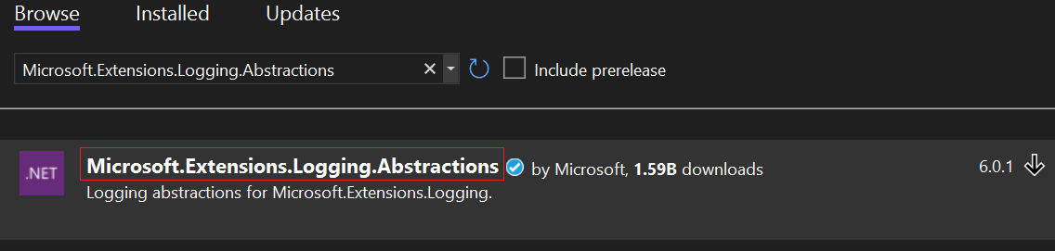
Logging in ASP .NET Core
Logging is done in ASP .NET Core by dependency injecting an instance of either ILogger or the ILogger<T> interface.
The ILogger or the ILogger<T> interface is found under the namespace Microsoft.Extensions.Logging
For non ASP .NET Core applications like console or WPF applications we can have the logging functionality by installing the following nuget package.
Install-Package Microsoft.Extensions.Logging.Abstractions -Version 6.0.1

Slide 10
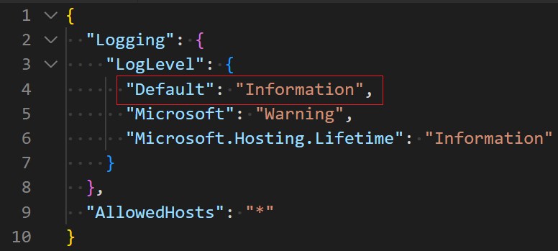
ILogger<T> has some useful extension methods which can log either messages or exceptions with a particular log level.
LogTrace
LogDebug
LogInformation
LogWarning
LogError
LogCritical
We can specify the minimum log level of our application in the appsettings.{Environment}.json file.

Slide 11
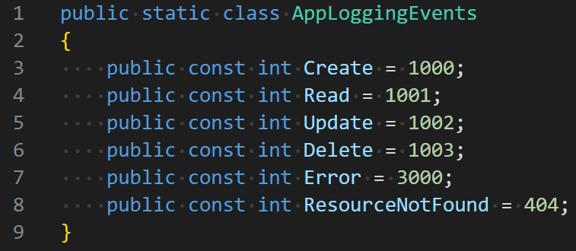
Logging EventId(s)
The EventId parameter which can be used to group related log messages by an event.
EventId’s can be created using the EventId struct or regular int.
If we use regular integers, then an implicit casting takes place to EventId struct.
Let’s say our application has identifier mapping in a POCO like this –
So, we can pass the EventId as a parameter to the extension methods as follows –

Slide 12
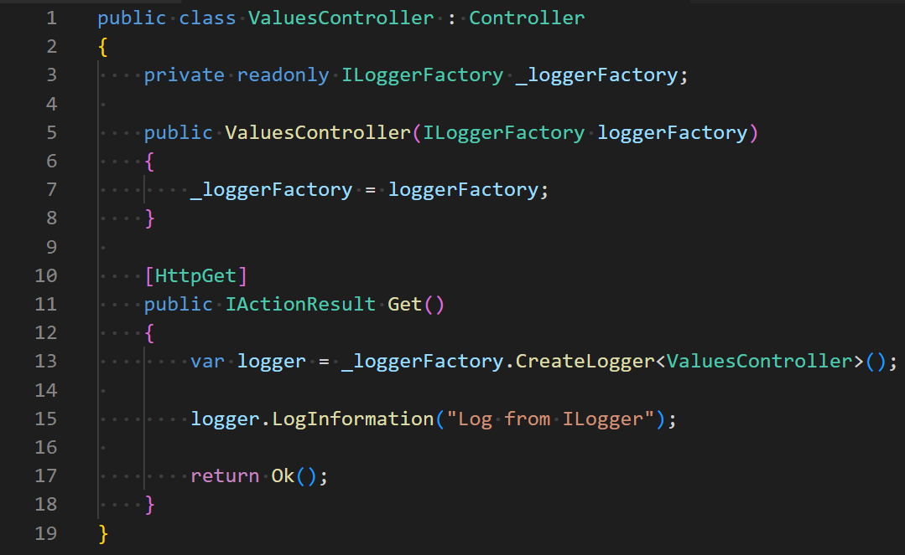
To use logging in our ASP .NET Core application we can use any of the two ways –
1. Inject ILoggerFactory interface

Slide 13
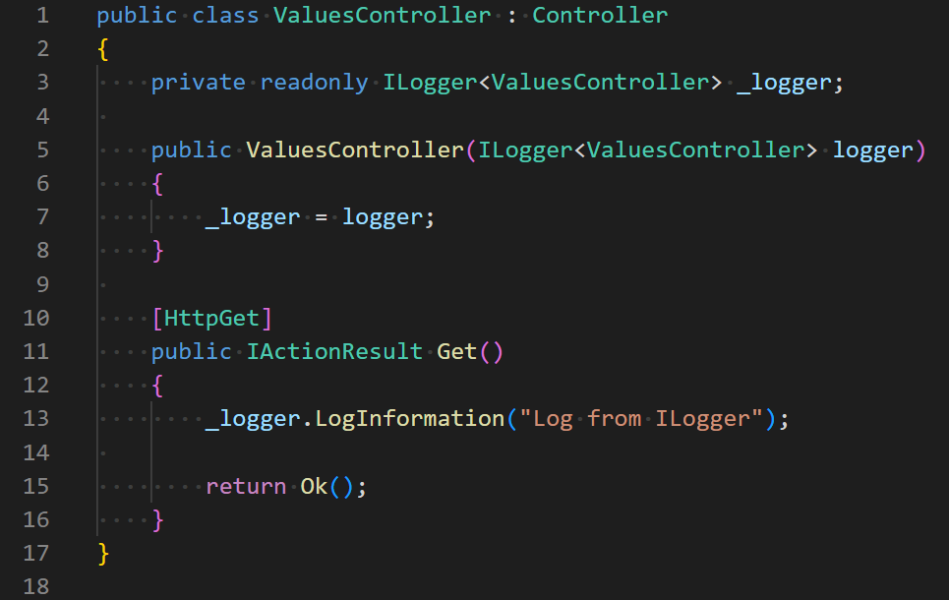
2. Inject ILogger<T> interface

Slide 14
Log Scopes
We can group certain operations under a logical scope and log that scope specially.
To create a log scope we use the ILogger<T>.BeginScope method. This methods implements IDisposable and is meant for short living scopes until it is disposed.
Log scopes should be used with caution and should be used under special scenarios.

Slide 15
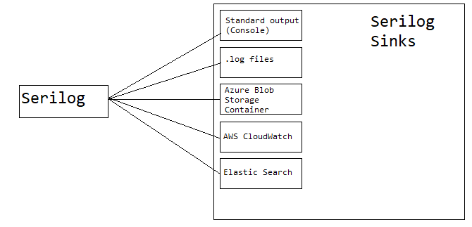
Serilog
Serilog is the preferred library for doing structured logging in ASP .NET Core
It supports a variety of logging destinations referred to as Sinks.
Logs can be either stored in Common log format or JSON.

Slide 16
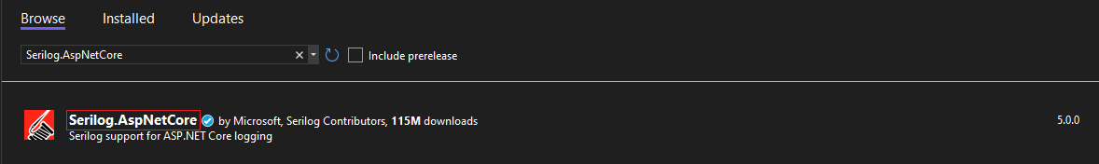
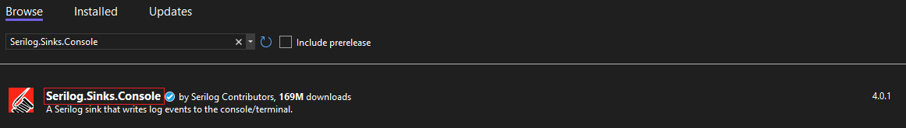
Serilog SDK
To get started, install these nuget packages -
ASP .NET Core –
Install-Package Serilog.AspNetCore -Version 5.0.0
For various sinks –
Install-Package Serilog.Sinks.Console -Version 4.0.1

Slide 17
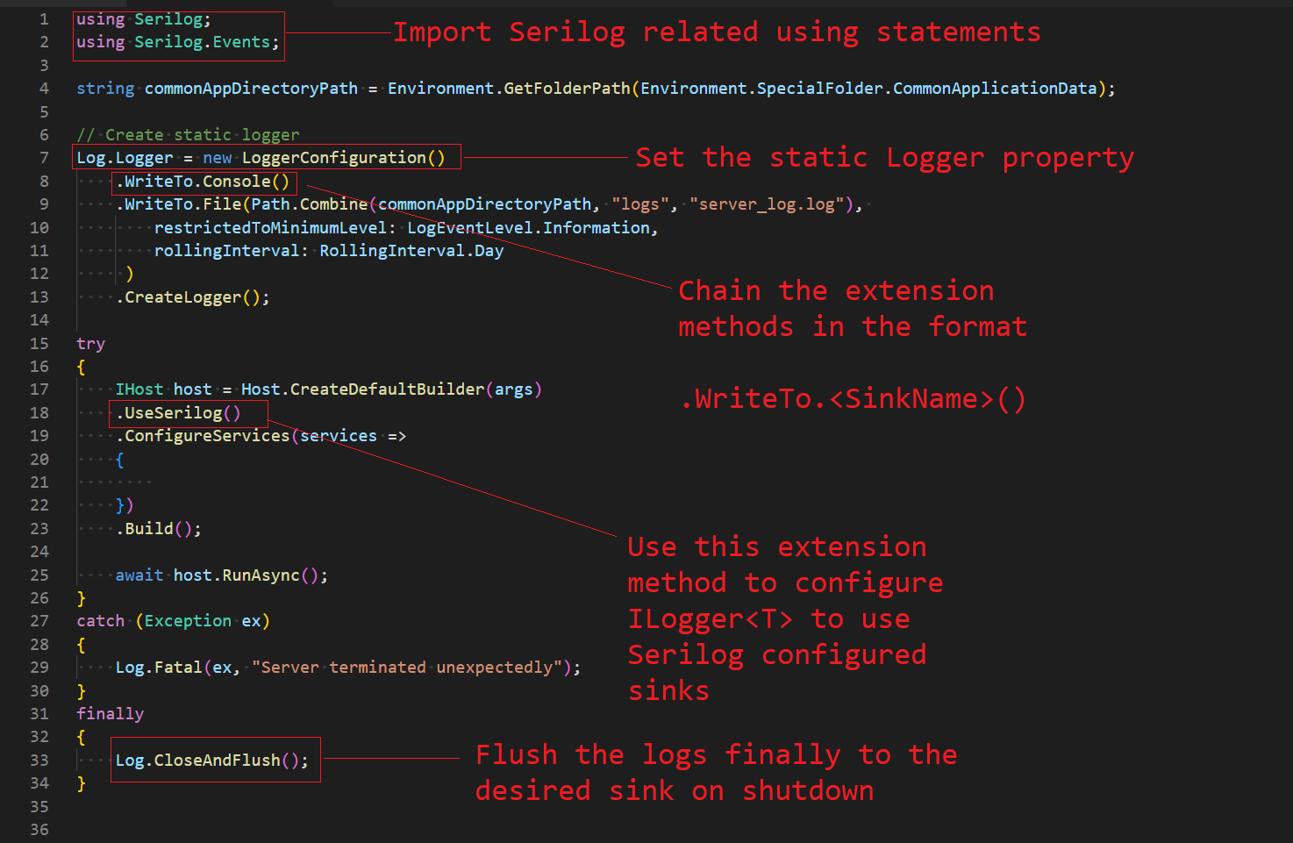
Quick start with Serilog

Slide 18
Enriching Serilog logs
We can push additional information which helps give context about a particular event.
We can “enrich” our logs by adding information like –
LogContext
MachineId
ThreadId
ProcessId
CorrelationId
Enrichers can be specified using either –
Enrich.With (Fluent API extension methods)
LoggerConfiguration (from appsettings.<Environment>.json file)

Slide 19
Serilog Console Sink Demo

Slide 20
Serilog Azure Table Storage Sink Demo

Slide 21
Serilog Azure Blob Storage Container Sink Demo

Slide 22
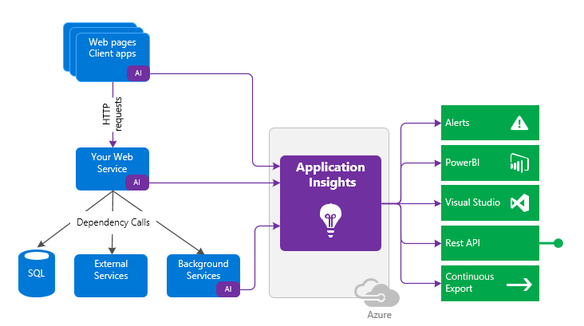
Azure Application Insights
Azure Application Insights is an Application Performance Management (APM) as a sub service under Azure Monitor.
It is used for –
Monitoring
Logging
Analytics
Azure Application Insights can be created as –
Standalone resource (Will be deprecated on 29/02/2024)
Workspace based (Attached to a resource) Preferred way

Slide 23
Data collected as part of Application Insights
Azure App Insights
HTTP requests
Exceptions
Custom Metrics
Traces
External Dependencies
To send telemetry for any of our applications to Azure Application Insights we need any one of the following
Instrumentation key (Will be deprecated on 31/03/2025)
Connection String (Recommended way)
All these 5 data models can be queried in the Azure Application Insights query window using a custom query language called the Kusto Query Language (KQL)

Slide 24
Enabling Application Insights
Azure Application Insights
Auto Instrumentation (Agent Based/Codeless attach)
Application Insights SDK

Slide 25
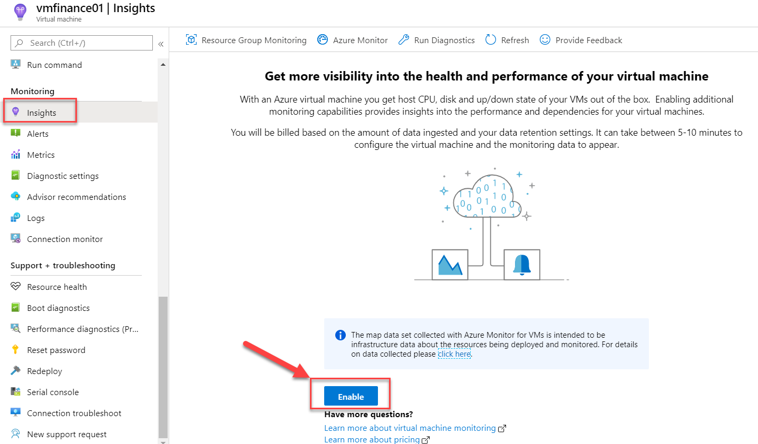
Auto Instrumentation (Agent Based)
Method 1 – Using PowerShell
// 1. Install package manager for PowerShell
PS > Install-Module –Name PackageManagement
// 2. Install the application monitor module which works in IIS
PS > Install-Module –Name Az.ApplicationMonitor
// 3. Enable application insights monitoring and provide your instrumentation key
PS > Enable-ApplicationInsightsMonitoring –InstrumentationKey <YOUR_INSTRUMENTATION_KEY>
Agent based scenario works best for the following situations –
Cannot change source code
Do not have access to source code
Cannot redeploy code
Code is already released to production
Benefits of Agent Based logging is logging is done out of process which is independent of the web server process.
Agent based application insights logging can be done in two ways –
Using PowerShell (Suited for On-Premise VM(s))
Using Detailed monitoring option (Suited for Azure VM(s))
Method 2 – Using Detailed Monitoring Option

Slide 26
Application Insights SDK
.NET Framework and .NET Core – ILogger<T>, Serilog and, NLog, System.Diagonostics.Trace
Java – Application Insights JAR and Logback
Node.js – Application Insights NPM module
Python – OpenCensus PIP package
JavaScript SPA Frameworks (React, Angular or Vue) - Application Insights JavaScript SDK – Web NPM module
Non-SPA Web Apps (Vanilla JavaScript or jQuery) – Add this script inside the <head> tag which will run before DOMContentLoaded event.

Slide 27
Application Insights Advanced Features
Application Map – Visually look at the application and the different calls or dependency its associated with. Each node on the map represents an application component or its dependencies.
Transaction Search – Specifically search telemetry using search terms, date filters, etc.
Failures – Allows to analyze and categorize the failures / exceptions in our application.
Performance – This helps us in drilling down the turn around time of each HTTP request our application is receiving.
Availability tests – Helps in checking whether our application is up and running by pinging an uptime API at regular intervals.
Profiler – Shows the time spent in each method call.
Snapshot Debugger – Takes a snapshot of the application when an exception occurs, and the snapshot contains the state of the application during that time including local variables, line numbers, etc.
Smart Detection – These get triggered when either of the following anomalies occur
Failure Anomaly
Performance Anomaly

Slide 28
Telemetry Initializers and Telemetry Processors
Telemetry Initializers are used to enrich telemetry using custom properties.
Telemetry processors are used to filter telemetry to reduce billing costs. It uses a process called as Sampling.
Note: Sampling does not reduce ingestion of the logs, but it reduces retention of the logs.
Sampling can be of 3 types –
Adaptive Sampling
Automatically adjust and drop the volume of logs being sent from the application.
It is the default sampling method.
Fixed-Rate Sampling
Developer decides the percentage volume of logs to drop.
Ingestion Sampling
Drops some percentage (1%, 2%, 4%, 8.3%, 12.5%, 25%, 33.3%, 50% and 100%) of the logs based on developer selection
We can set the sampling percentage at runtime without application redeployment.
Logs which have the same OperationId value will be either all be dropped, or all retained.

Slide 29
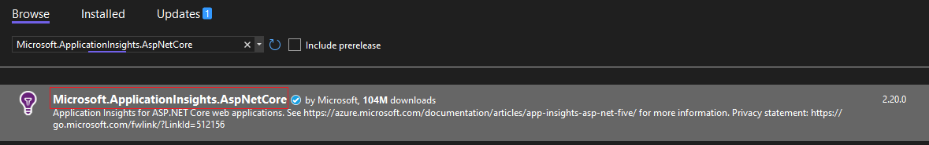
Azure Application Insights C# SDK
To get started with logging into Azure Application Insights from ASP .NET Core install this nuget package.
Install-Package Microsoft.ApplicationInsights.AspNetCore -Version 2.20.0

Slide 30
Azure Application Insights ASP .NET Core Demo

Slide 31
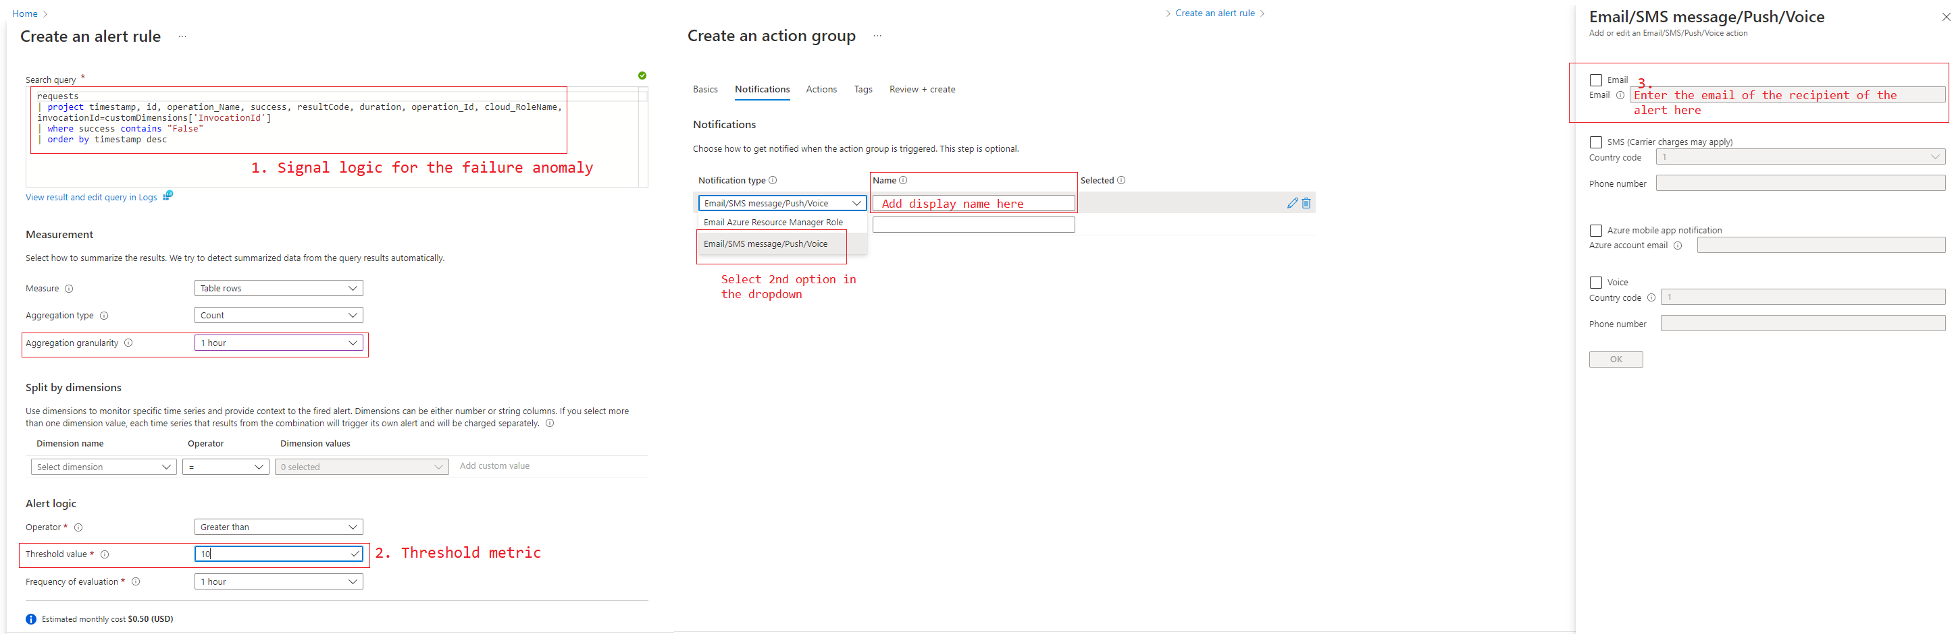
Creating Alerts for Failure Anomalies
We can create alerts for reacting for Failure Anomalies in our application.
To create an alert, we need the following things –
Alert query (Signal logic)
Threshold metric (Acceptable value of failures)
Action Group (Recipients of the alert)

Slide 32
Application Insights Pricing
Below is a reference case study of pricing for the East US Azure region.
Pricing for specific regions can be seen here.
Area | Pricing
Logs | Pay As You Go - $2.30 per GB (First 5 GB free in monthly quota) 100 GB / day - $196 / day 200 GB / day - $368 / day 300 GB / day - $540 / day 400 GB / day - $704 / day 500 GB / day - $865 / day 1000 GB / day - $1700 / day 2000 GB / day - $3320 / day 5000 GB / day - $8050 / day
Retention Period | 31 or 90 days
Availability tests (Ping tests) | Free
Alerts | 15 min or greater interval - $ 0.50 per alert invocation 10 min - $ 1 per alert invocation 5 min - $ 1.50 per alert invocation 1 min - $ 3.00 per alert invocation

